Slide 1

Control Structures in R
Dr. Rakhee Chhibber

Slide 2
Taking input in R
There are two methods in R.
Using readline() method
Using scan() method

Slide 3
Using readline() method
In R language readline() method takes input in string format. If one inputs an integer then it is inputted as a string, lets say, one wants to input 255, then it will input as “255”, like a string. So one needs to convert that inputted value to the format that he needs. In this case, string “255” is converted to integer 255. To convert the inputted value to the desired data type, there are some functions in R,
as.integer(n); —> convert to integer
as.numeric(n); —> convert to numeric type (float, double etc)
as.complex(n); —> convert to complex number (i.e 3+2i)
as.Date(n) —> convert to date …, etc

Slide 4
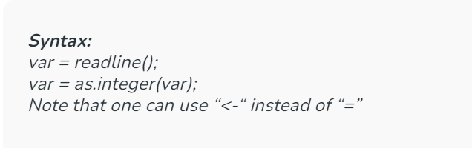
Reading input through keyboard
# R program to illustrate
# taking input from the user
# taking input using readline()
# this command will prompt you
# to input a desired value
var = readline();
# convert the inputted value to integer
var = as.integer(var);
# print the value
print(var)

Slide 5
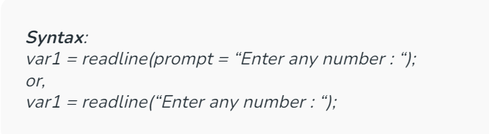
Prompt a message
One can also show message in the console window to tell the user, what to input in the program. To do this one must use a argument named prompt inside the readline() function. Actually prompt argument facilitates other functions to constructing of files documenting. But prompt is not mandatory to use all the time.
# R program to illustrate
# taking input from the user
# taking input with showing the message
var = readline(prompt = "Enter any number : ");
# convert the inputted value to an integer
var = as.integer(var);
# print the value
print(var)

Slide 6
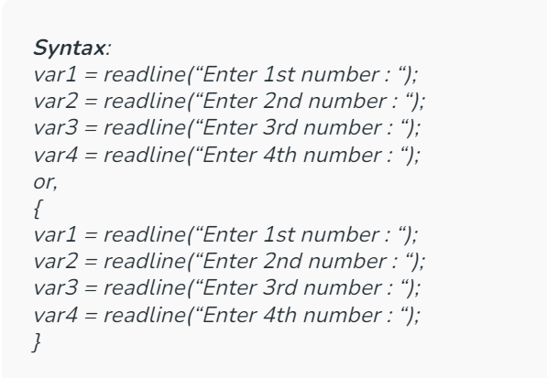
multiple inputs in R

Slide 7
# R program to illustrate
# taking multiple inputs
# using braces
{
var1 = readline("Enter 1st number : ");
var2 = readline("Enter 2nd number : ");
var3 = readline("Enter 3rd number : ");
var4 = readline("Enter 4th number : ");
}
# converting each value
var1 = as.integer(var1);
var2 = as.integer(var2);
var3 = as.integer(var3);
var4 = as.integer(var4);
# print the sum of the 4 number
print(var1 + var2 + var3 + var4)

Slide 8
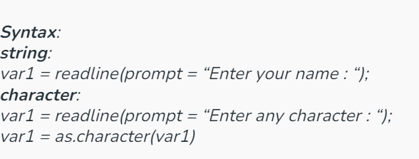
String and Character input in R
For “String” one doesn’t need to convert the inputted data into a string because R takes input as string always. And for “character”, it needs to be converted to ‘character’. Sometimes it may not cause any error. One can take character input as same as string also, but that inputted data is of type string for the entire program. So the best way to use that inputted data as ‘character’ is to convert the data to a character.

Slide 9
# R program to illustrate
# taking input from the user
# string input
var1 = readline(prompt = "Enter your name : ");
# character input
var2 = readline(prompt = "Enter any character : ");
# convert to character
var2 = as.character(var2)
# printing values
print(var1)
print(var2)

Slide 10
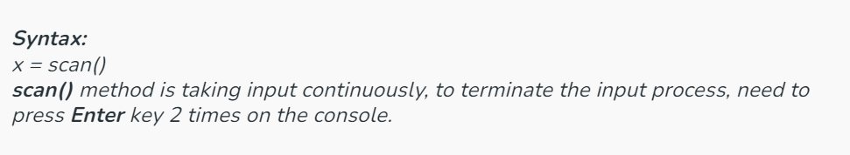
Using scan() method
Another way to take user input in R language is using a method, called scan() method. This method takes input from the console. This method is a very handy method while inputs are needed to taken quickly for any mathematical calculation or for any dataset. This method reads data in the form of a vector or list. This method also uses to reads input from a file also.

Slide 11
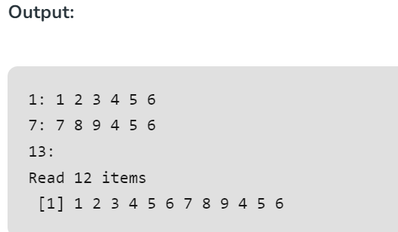
# R program to illustrate
# taking input from the user
# taking input using scan()
x = scan()
# print the inputted values
print(x)
Explanation: Total 12 integers are taking as input in 2 lines when the control goes to 3rd line then by pressing Enter key 2 times the input process will be terminated.

Slide 12
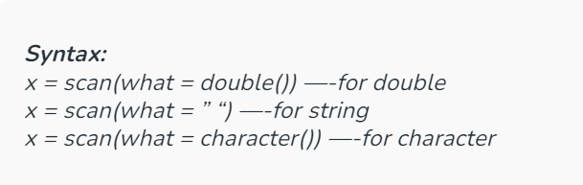
double, string, character type values using scan() method
To take double, string, character types inputs, specify the type of the inputted value in the scan() method. To do this there is an argument called what, by which one can specify the data type of the inputted value.

Slide 13
# R program to illustrate
# taking input from the user
# double input using scan()
d = scan(what = double())
# string input using 'scan()'
s = scan(what = " ")
# character input using 'scan()'
c = scan(what = character())
# print the inputted values
print(d) # double
print(s) # string
print(c) # character

Slide 14
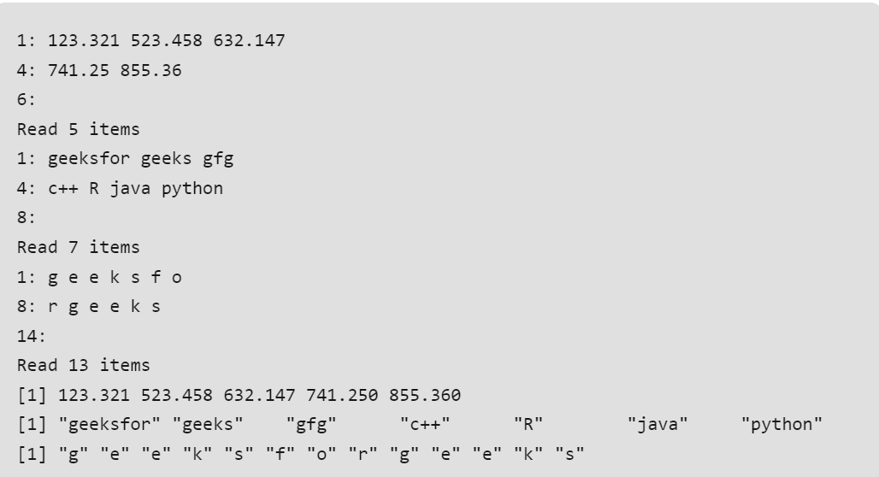

Slide 15
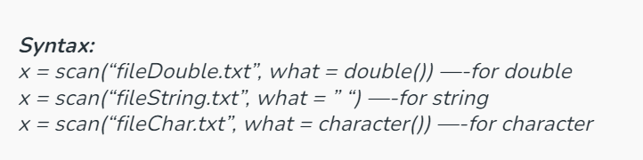
Read File data using scan() method
To read file using scan() method is same as normal console input, only thing is that, one needs to pass the file name and data type to the scan() method.

Slide 16
# R program to illustrate
# taking input from the user
# string file input using scan()
s = scan("fileString.txt", what = " ")
# double file input using scan()
d = scan("fileDouble.txt", what = double())
# character file input using scan()
c = scan("fileChar.txt", what = character())
# print the inputted values
print(s) # string
print(d) # double
print(c) # character

Slide 17
Print statement in R

Slide 18
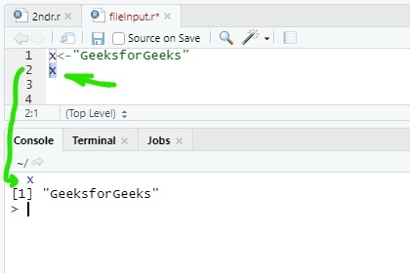
Print without print function
# select 'x' and then press 'run' button
# it will print 'GeeksforGeeks' on the console
x <- "GeeksforGeeks"
x

Slide 19
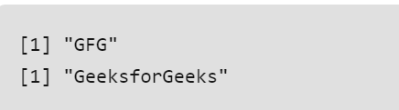
Print output using print() function
# R program to illustrate
# printing output of an R program print string
print("GFG")
# print variable
# it will print 'GeeksforGeeks' on the console
x <- "GeeksforGeeks"
print(x)

Slide 20
Print output using paste() function inside print() function
R provides a method paste() to print output with string and variable together. This method defined inside the print() function. paste() converts its arguments to character strings. One can also use paste0() method.
Note: The difference between paste() and paste0() is that the argument sep by default is ” “(paste) and “”(paste0).

Slide 21
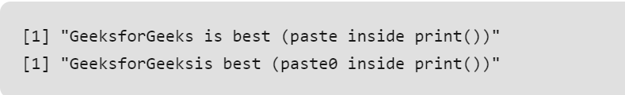
# R program to illustrate
# printing output of an R program
x <- "GeeksforGeeks"
# using paste inside print()
print(paste(x, "is best (paste inside print())"))
# using paste0 inside print()
print(paste0(x, "is best (paste0 inside print())"))

Slide 22
Print output using sprintf() function
sprintf() is basically a C library function. This function is use to print string as C language. This is working as a wrapper function to print values and strings together like C language. This function returns a character vector containing a formatted combination of string and variable to be printed.

Slide 23
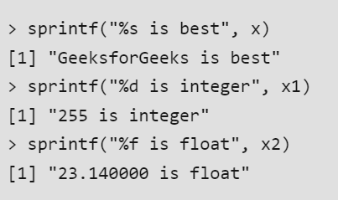
# R program to illustrate
# printing output of an R program
x = "GeeksforGeeks" # string
x1 = 255 # integer
x2 = 23.14 # float
# string print
sprintf("%s is best", x)
# integer print
sprintf("%d is integer", x1)
# float print
sprintf("%f is float", x2)

Slide 24
Print output using cat() function
Another way to print output in R is using of cat() function. It’s same as print() function. cat() converts its arguments to character strings. This is useful for printing output in user defined functions.
# R program to illustrate
# printing output of an R program
# print string with variable
# "\n" for new line
x = "GeeksforGeeks"
cat(x, "is best\n")
# print normal string
cat("This is R language")

Slide 25
Introduction
Control Structures are an integral part of any programming language. We can say that a programming language without control structures is incomplete. These control structures are basically a block of code lines that decide which direction to go once the executed and often called as well as considered as loops. Control structures are mostly used for decision making.
If – else statement
ifelse() function
Switch Statement
for loop
while loop
Break Statement
Next Statement
Report Loops

Slide 26
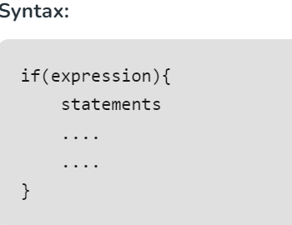
If..condition
x <- 100
if(x > 10){
print(paste(x, "is greater than 10"))
}

Slide 27
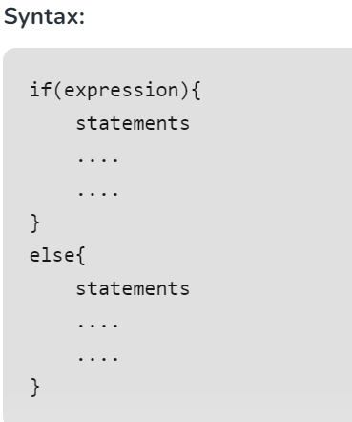
If..else condition
x <- 5
# Check value is less than or greater than 10
if(x > 10){
print(paste(x, "is greater than 10"))
}else{
print(paste(x, "is less than 10"))
}

Slide 28
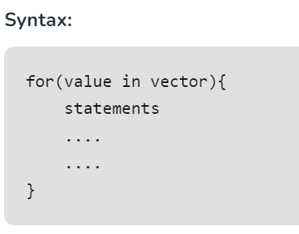
For loop
x <- letters[4:10]
for(i in x){
print(i)
}

Slide 29
Nested loops
# Defining matrix
m <- matrix(2:15, 2)
for (r in seq(nrow(m))) {
for (c in seq(ncol(m))) {
print(m[r, c])
}
}

Slide 30
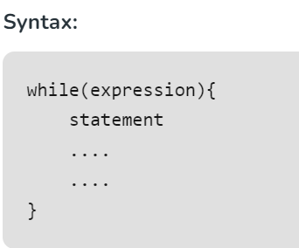
While loop
x = 1
# Print 1 to 5
while(x <= 5){
print(x)
x = x + 1
}

Slide 31
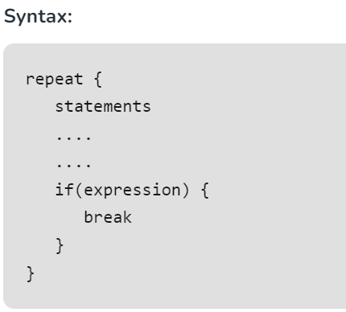
repeat loop and break statement
repeat is a loop which can be iterated many number of times but there is no exit condition to come out from the loop. So, break statement is used to exit from the loop. break statement can be used in any type of loop to exit from the loop.
x = 1
# Print 1 to 5
repeat{
print(x)
x = x + 1
if(x > 5){
break
}
}

Slide 32
return statement
# Checks value is either positive, negative or zero
func <- function(x){
if(x > 0){
return("Positive")
}else if(x < 0){
return("Negative")
}else{
return("Zero")
} }
#Function calling
func(1)
func(0)
func(-1)
return statement is used to return the result of an executed function and returns control to the calling function.

Slide 33
next statement
next statement is used to skip the current iteration without executing the further statements and continues the next iteration cycle without terminating the loop.
# Defining vector
x <- 1:10
# Print even numbers
for(i in x){
if(i%%2 != 0){
next #Jumps to next loop
}
print(i)
}

Slide 34
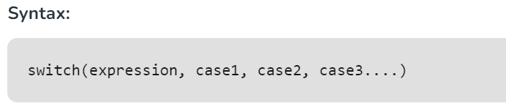
Switch case
Important Points about Switch Case Statements:
An expression type with character string always matched to the listed cases.
An expression which is not a character string then this exp is coerced to integer.
For multiple matches, the first match element will be used.
No default argument case is available there in R switch case.
An unnamed case can be used, if there is no matched case.

Slide 36
# Following is val1 simple R program
# to demonstrate syntax of switch.
# Mathematical calculation
val1 = 6
val2 = 7
val3 = "s"
result = switch(
val3,
"a"= cat("Addition =", val1 + val2),
"d"= cat("Subtraction =", val1 - val2),
"r"= cat("Division = ", val1 / val2),
"s"= cat("Multiplication =", val1 * val2),
"m"= cat("Modulus =", val1 %% val2),
"p"= cat("Power =", val1 ^ val2)
)
print(result)

